Slide 1
From reactive to proactive: the metamorphosis of antiviruses
Radosław Kumorek
SFI 2024

Slide 2
anegdota

Slide 3
Statisctics
new viruses detected per day
560 000
Existing malwares
1 000 000 000

Slide 4
History
1966
Theoretical malware by John von Neumann
1966
Creeper worm by Bob Thomas (not malicious)
1966
Elk Cloner virus by Rick Skrenta

Slide 5
Malware
Trojan
Ransomware
MALWARE (MALICIOUS SOFTWARE)
Spyware
Adware
Rootkit
Keylogger
Bots

Slide 6

Black hat
Blackhat – computer hacker who violates laws

Slide 7
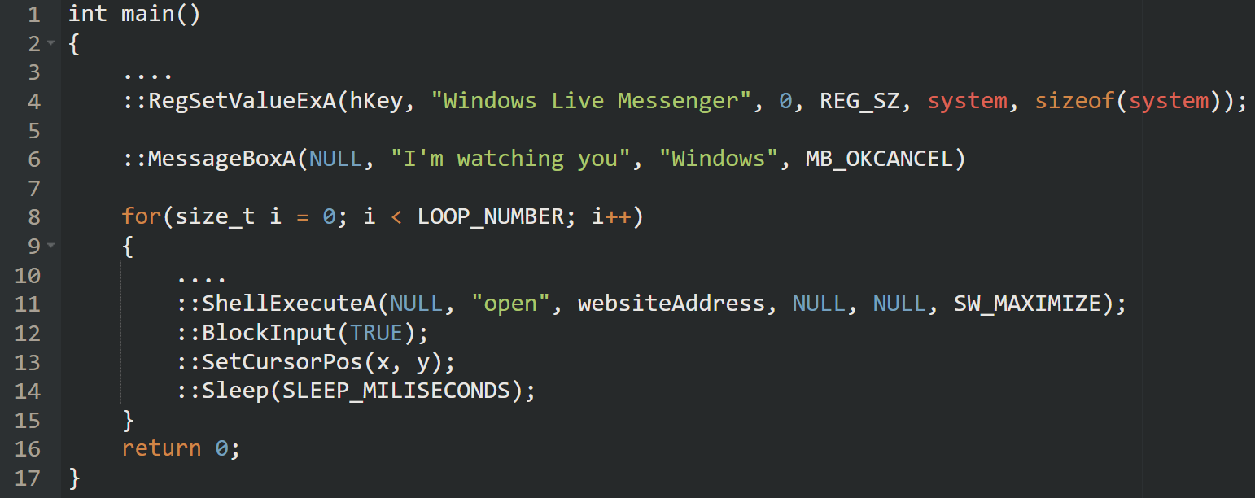
Wacatac

Slide 8
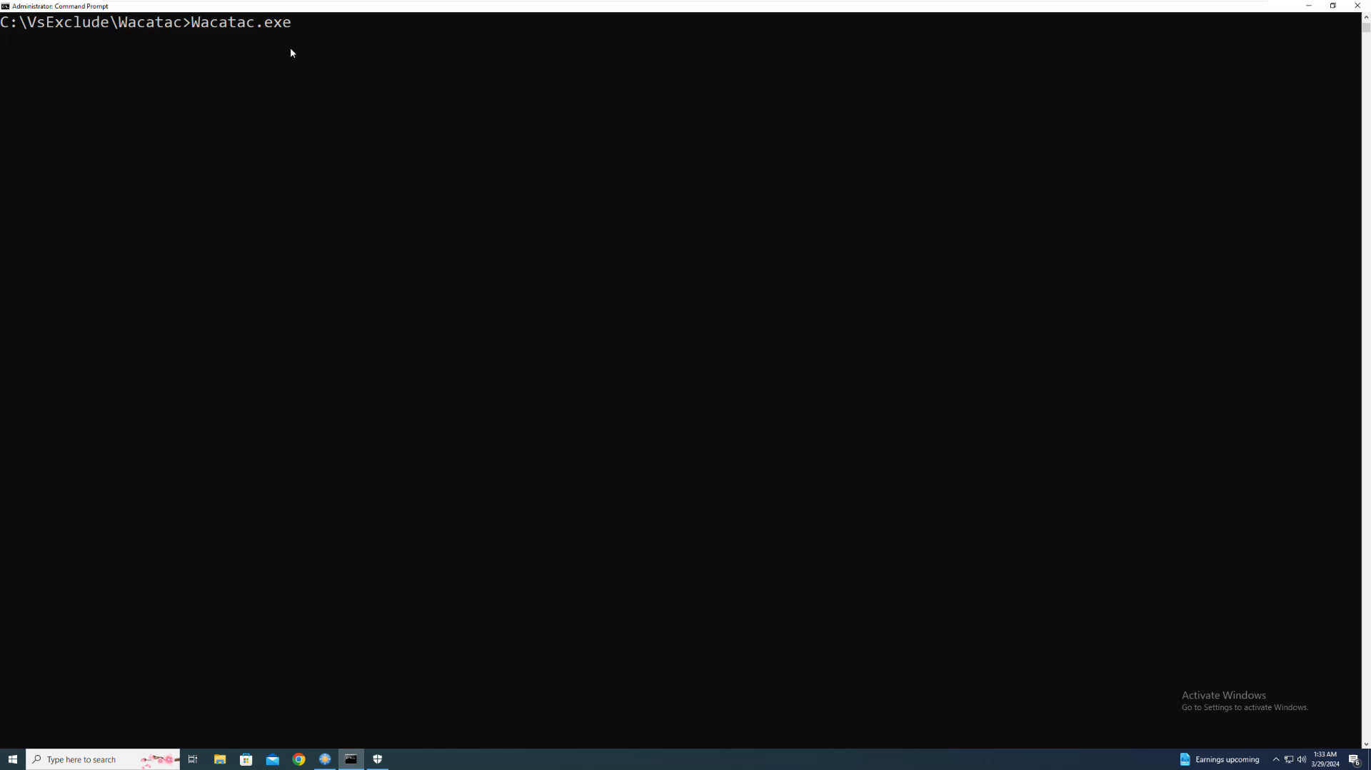
Wacatac

Slide 9


STATIC ANALYSIS
Types of detection/analysis
Static analysis in cybersecurity
Static analysis in car mechanics
scanning a file before launch
Checking the car before starting the engine

Slide 10

STATIC ANALYSIS
Simplest detection
Malwares database
File
Is the file in the database?

Slide 11

STATIC ANALYSIS
Comparing files
Compare files byte by byte? low efficiency
Compare sizes? not deterministic

Slide 12
STATIC ANALYSIS
Hash function
FILE
SHA256
CHECKSUM

Slide 13
STATIC ANALYSIS
Hash function
notepad.exe
SHA256
87F53BC444C05230CE439DBB127C03F2E374067D6FB08E91C834371FD9ECF661

Slide 14
STATIC ANALYSIS
Simplest detection
Malwares SHA database
File
SHA256
Is SHA in the database?
Checksum

Slide 15
STATIC ANALYSIS
Algorithm
fn scan() {
...
let signatures = load_signatures(sigs_path);
let sha256 = calculate_sha256_from_file(file);
let detection = signatures.match(sha256);
if detection.is_malicious() {
// do action
}
...
}

Slide 16
STATIC ANALYSIS
Wacatac_sha.sig
name: Watacat.exe
description: <malware description>
sha256:9CB63AE435458E97697A04255DD0655724E89F98026FED152EE1D36F8CA5EB0E

Slide 17
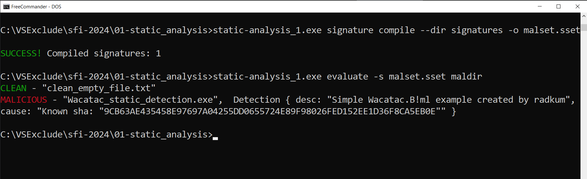
STATIC ANALYSIS
Example

Slide 18
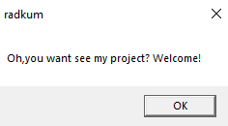
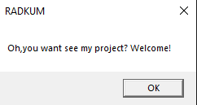
STATIC ANALYSIS
Evading
Wacatac_v1.exe
Wacatac_v2.exe
9CB63AE435458E97697A04255DD0655724E89F98026FED152EE1D36F8CA5EB0E
B43043CFC7B24FBABE9CB37634F081370CF25878D0054FB9578128F3895ED82F

Slide 19
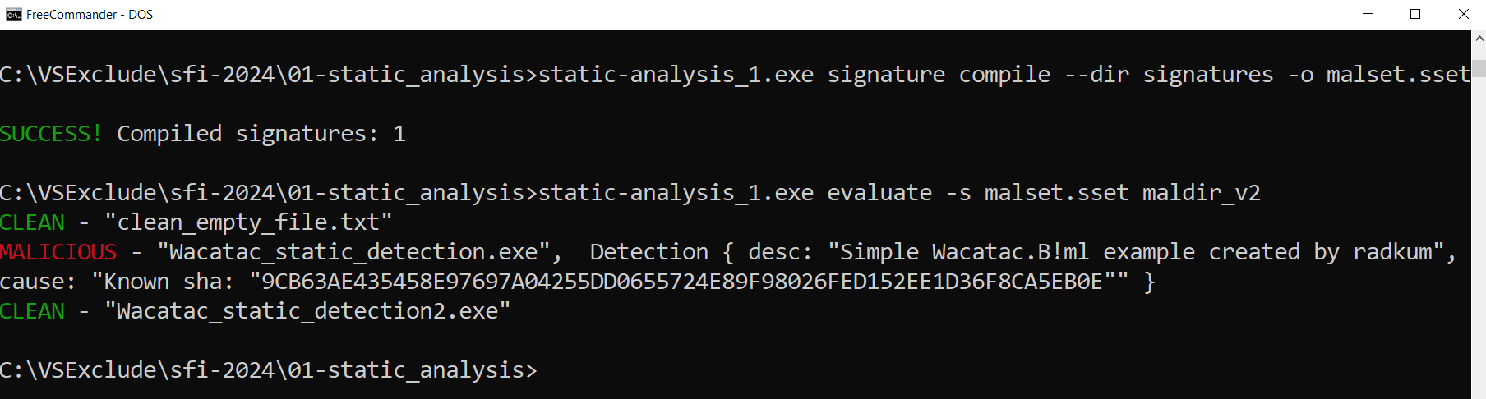
STATIC ANALYSIS
Evading - example

Slide 20
STATIC ANALYSIS
Malwares similarities
RESOURCES
IMPORTS
STRINGS

Slide 21
STATIC ANALYSIS
Algoritm - heuristics
fn scan() {
...
let signatures = load_signatures(sigs_path);
let heuristics = parse_executable(file);
let detection = signatures.match(heuristics);
if detection.is_malicious() {
// do action
}
...
}

Slide 22
STATIC ANALYSIS
Wacatac_heur.sig
name: Watacat.exe
description: <malware description>
calls: [Sleep, BlockInput, SetCursorPos, ShellExecuteW, MessageBoxW, RegSetValueExW]

Slide 23
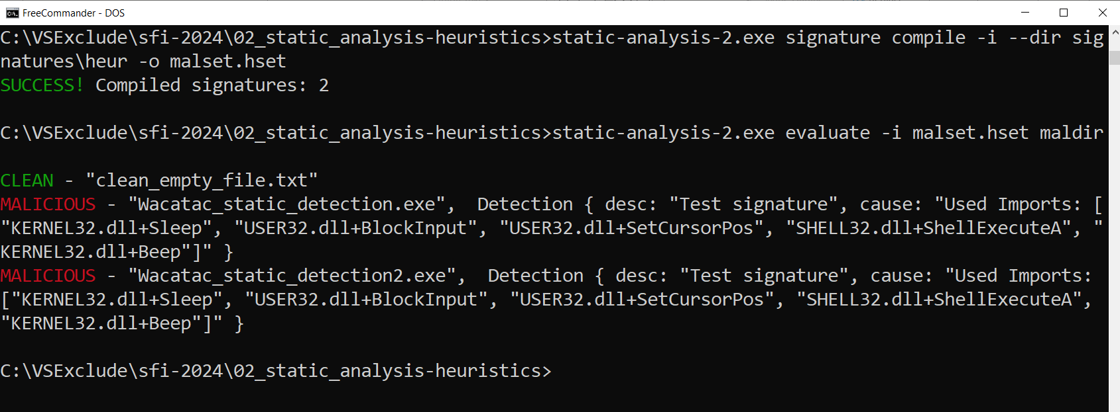
STATIC ANALYSIS
Example

Slide 24
STATIC ANALYSIS
False positives
 | Antyvirus detection | No detection
It’s malware | TRUE POSITIVE (malware correctly detected) | FALSE NEGATIVE (malware not detected)
Clean file | FALSE POSITIVE (clean file improperly detected) | TRUE NEGATIVE (clean file correctly not detected)

Slide 25
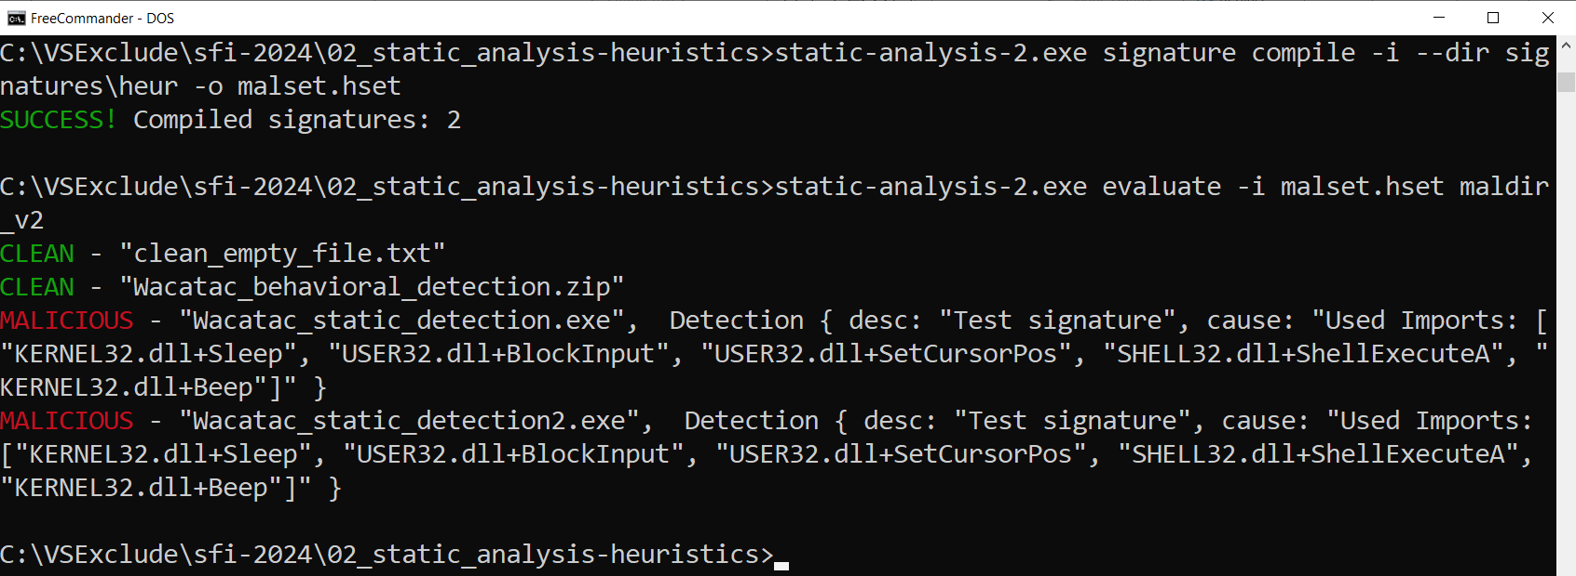
STATIC ANALYSIS
Evading - example

Slide 26

STATIC ANALYSIS
Archives
Typical archives
ZIP
TAR
RAR
Files which store objects
DOCX
APK
MSI
Self extracting (SFX)
UPX

Slide 27
STATIC ANALYSIS
Algorithm
fn scan() {
...
scan_file(file);
if is_archive(file) {
// extract to memory and add
// to the queue of files for scanning
}
...
}

Slide 28
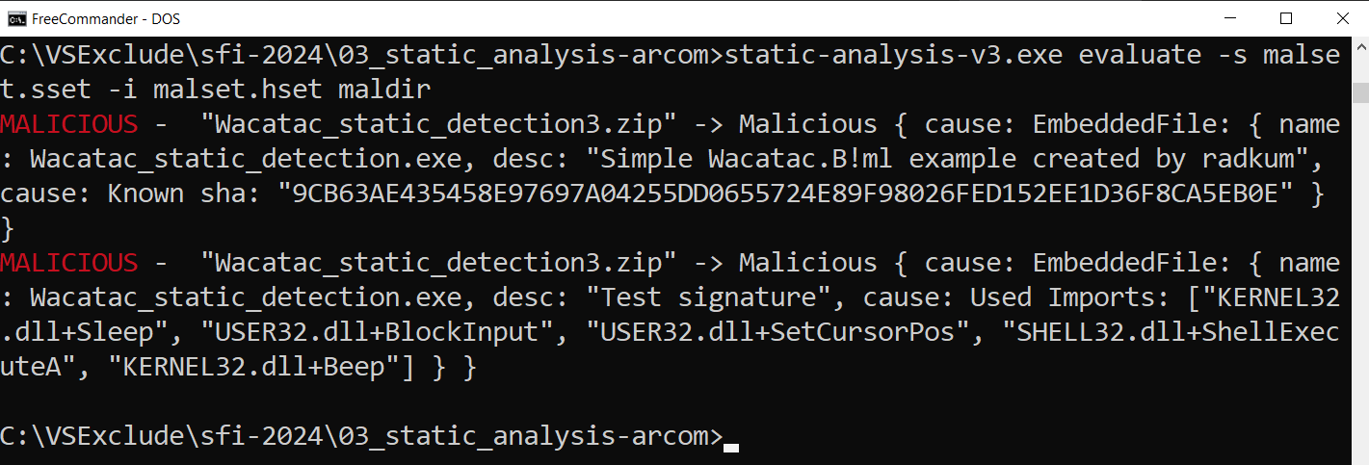
STATIC ANALYSIS
Example

Slide 29
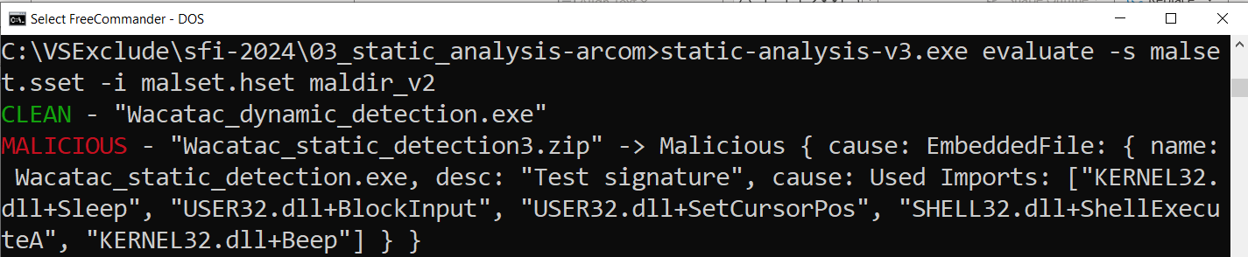
STATIC ANALYSIS
Evading - example

Slide 30
DYNAMIC ANALYSIS
Types of detection/analysis
Dynamic analysis in cybersecurity
Dynamic analysis in car mechanics
run file in „safe” environment
Start engine remotely on desert

Slide 31
DYNAMIC ANALYSIS
Obfuscation
Encrypted strings
Dynamic library loading
LoadLibrary
GetProcAdress
jdqmdk21
decrypt
kernel32
// function sleep example
HMODULE hLib = LoadLibrary("kernel32.dll");
FnType ptrSleepFn =
(FnType) GetProcAdress(kernel32, "Sleep");
ptrSleepFn("2000"); // sleep 2 seconds
Simple encryption: decrement each character
k => j
E => d
3 => 2
....

Slide 32

DYNAMIC ANALYSIS
Sandbox
ISOLATED ENVIRONMENT
FAKENET
filestytes
VIRTUALIZATION

Slide 33

DYNAMIC ANALYSIS
Quasi-Sandbox
NORMAL
HOOKED
API CALL
API CALL
MY FUNCTION
API FUNCTION
API FUNCTION

Slide 34
DYNAMIC ANALYSIS
Algorithm
fn scan() {
...
let signatures = load_signatures(sigs_path);
let api_calls = sandbox_file(file);
let detection = signatures.match(api_calls);
if detection.is_malicious() {
// do action
}
...
}

Slide 35
DYNAMIC ANALYSIS
Wacatac_dyn.sig
name: Watacat.exe
description: <malware description>
calls: [Sleep, BlockInput, SetCursorPos, ShellExecuteW, MessageBoxW, RegSetValueExW]

Slide 36
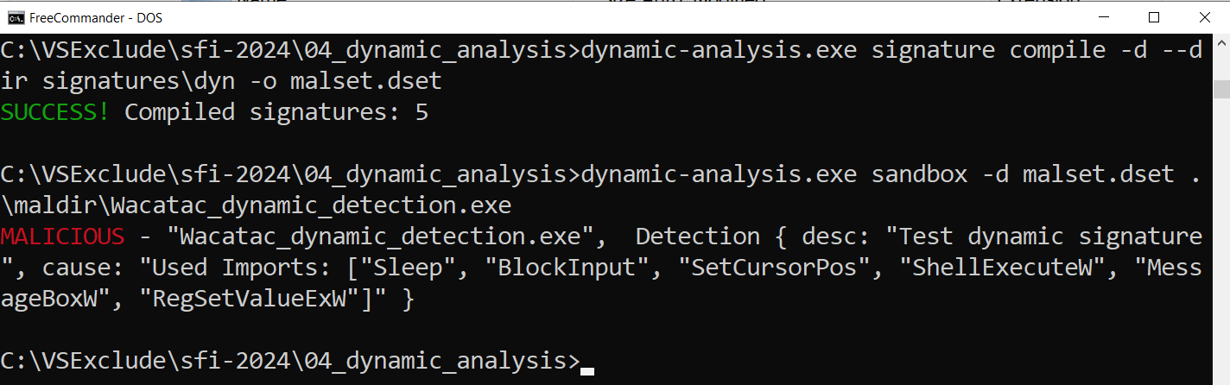
DYNAMIC ANALYSIS
Example

Slide 37
DYNAMIC ANALYSIS
Ant-VM Tricks
CPUID
PROCESS ENUMERATION
VM FILES
37

Slide 38
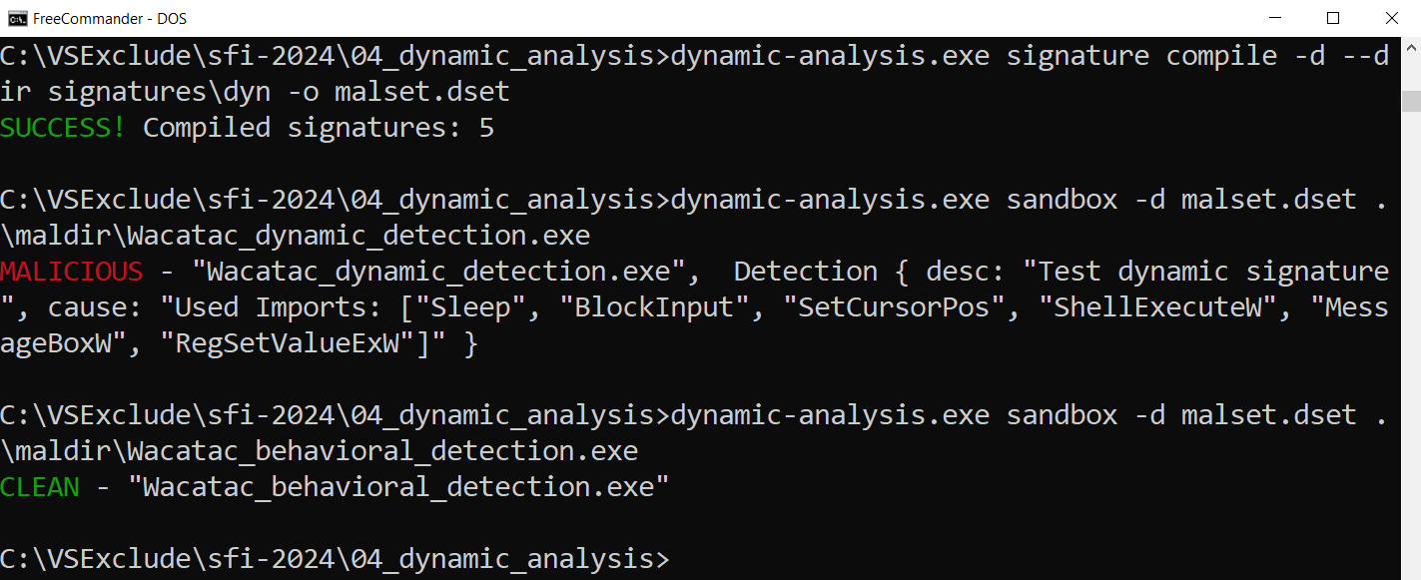
DYNAMIC ANALYSIS
Evading - example

Slide 39
BEHAVIOURAL ANALYSIS
Types of detection/analysis
Behavioural analysis in cybersecurity
Behavioural analysis in car mechanics
Process started normally, but we still monitor its behaviour
we start driving, but we keep the warning lights in mind

Slide 40
BEHAVIOURAL ANALYSIS
INFORMATION FLOW
USER MODE
MATCHING ENGINE (match event to signature)
EVENT
ACTION
KERNEL MODE
FEEDER (MINIFILTER/DRIVER)
ACTION HANDLER (DRIVER)

Slide 41
BEHAVIOURAL ANALYSIS
Algorithm
fn event_queue(signatures: &Signatures) {
loop {
let event = get_message(); // FilterGetMessage
let detection = signatures.match(event);
if detection.is_malicious() {
// send action to driver
}
}

Slide 42
BEHAVIOURAL ANALYSIS
Wacatac_beh.sig
name: Watacat.exe
description: <malware description>
event_type: RegSetValue
attributes:
value_name: Windows Live Messenger
key_name: \HKEY_LOCAL_MACHINE\SOFTWARE\Microsoft\Windows\CurrentVersion\Run
data: C:\WINDOWS\system32\evil.exe

Slide 43
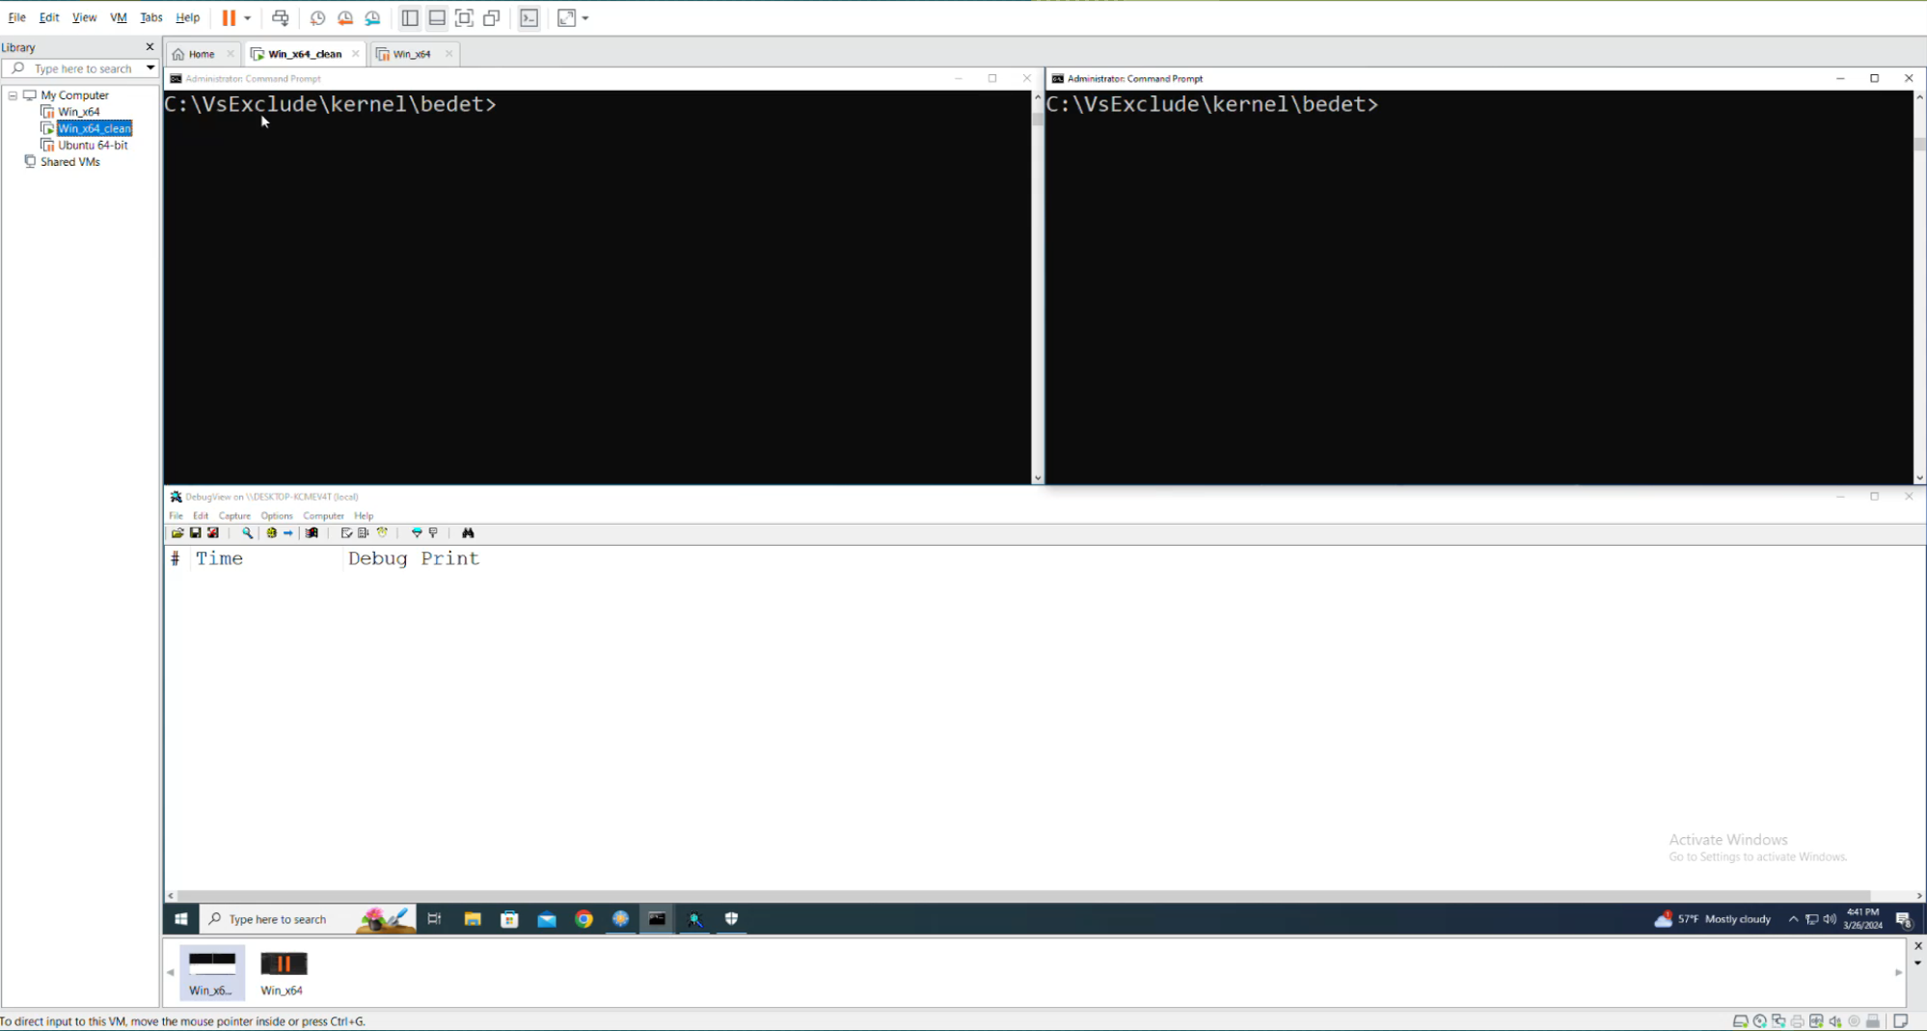
BEHAVIOURAL ANALYSIS
Example

Slide 44
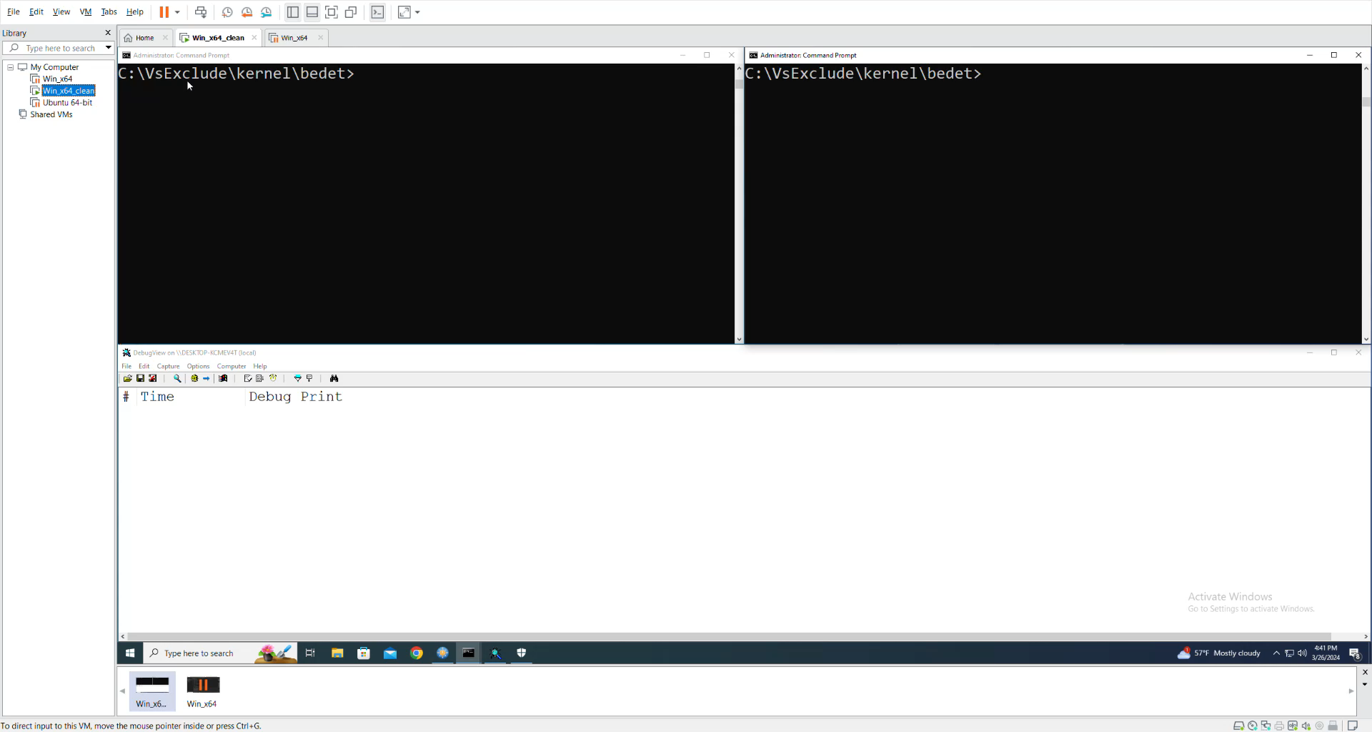
BEHAVIOURAL ANALYSIS
Example

Slide 45
Types of detection - summary
STATIC ANALYSIS | DYNAMIC ANALYSIS | BEHAVIOURAL ANALYSIS
SCAN A FILES ON DISK, WITHOUT RUN THEM (typically on create or on demand) | CREATE PROCESS IN STERILE/SAFE ENVIRONMENT (sandbox) | MONITOR PROCESS AND LOOK FOR MALICIOUS BEHAVIOUR

Slide 46
Other modules
FIREWALL
ELAM
ANTIRANSOMWARE
ACCESS CONTROL
ROOTKIT SCANNER

Slide 47
EDR
Endpoint Detection and Response
EDR
FIREWALL
SANDBOX
ANTYVIRUS
BEHAVIOURAL PROTECTION
. . .
. . .

Slide 48


XDR
Extended Detection and Response
XDR
SERVER
INFO
INFO
INFO
ENDPOINT
ENDPOINT
ENDPOINT

Slide 49
Is it worth it?
„Ordinary” users | „Active” users | Companies
NOT NECESSARY (using legal websites and software from a well-known source) | WORTH IT (downloading files from unverified source) | NECESSARY!!! (targeted by threat actors)

Slide 50
Thanks
Source: https://github.com/radkum

